Slide 1
Batsman Run Prediction using Machine Learning
Team Members
Adithyan Biju | Fidal Govind | Archana T
Predictive Analytics Course • IPL Dataset 2008–2020 • Kaggle

Slide 2
🎯 Problem Statement
Context
Objective
Cricket is one of the world's most popular sports and the IPL is its biggest tournament.
Teams, coaches, and analysts need data-driven tools to understand and predict player performance.
Predict IPL batsman runs using machine learning models trained on historical data from 2008–2020.
Apply SHAP explainability to understand which features drive predictions.

Slide 3
📂 Dataset Overview
179,078
816
13
2 Files
Total Deliveries
Matches
IPL Seasons
deliveries.csv + matches.csv
Key Features Used
Feature | Description | Feature | Description
batsman | Player name | batting_team | Team batting
bowler | Bowler name | bowling_team | Team bowling
venue | Match stadium | runs_scored | Target variable

Slide 4
🔄 Project Pipeline
1
2
3
4
5
Problem
Definition
Data
Collection
Pre-
processing
EDA
Feature
Engineering
Phase 1
6
7
8
9
10
Model
Building
Model
Evaluation
SHAP
Explainability
Deployment
Documentation
Phase 2

Slide 5
📊 Key EDA Findings
🏆 Top Run Scorer
📉 Flop Innings
Virat Kohli leads with 8,000+ runs. S Dhawan and RG Sharma follow closely.
55.6% of innings score 0–15 runs. Only 15.8% qualify as excellent (41+ runs).
📈 Scoring Trend
🏟️ Top Venue
Average runs per innings rose steadily from ~19 (2008) to 22+ (2024).
Punjab CA IS Bindra Stadium has the highest average runs per innings (~24).

Slide 6
🤖 Model Results
Simple Linear Regression
Accuracy: 68%
Baseline model
Logistic Regression
Accuracy: 71%
Good for classification
Multiple Linear Regression
Accuracy: 74%
Best performer ✓

Slide 7
🔍 SHAP Explainability
SHAP (SHapley Additive exPlanations) explains WHY the model made each prediction by showing each feature's contribution.
Feature Importance (SHAP Values)
💡 Key Insight
Batting Average
85%
Batting average is the strongest predictor of runs scored.
Strike rate and venue also significantly influence predictions.
The model aligns with real cricket domain knowledge.
Strike Rate
65%
Venue
45%
Batting Team
30%
Bowling Team
20%

Slide 8
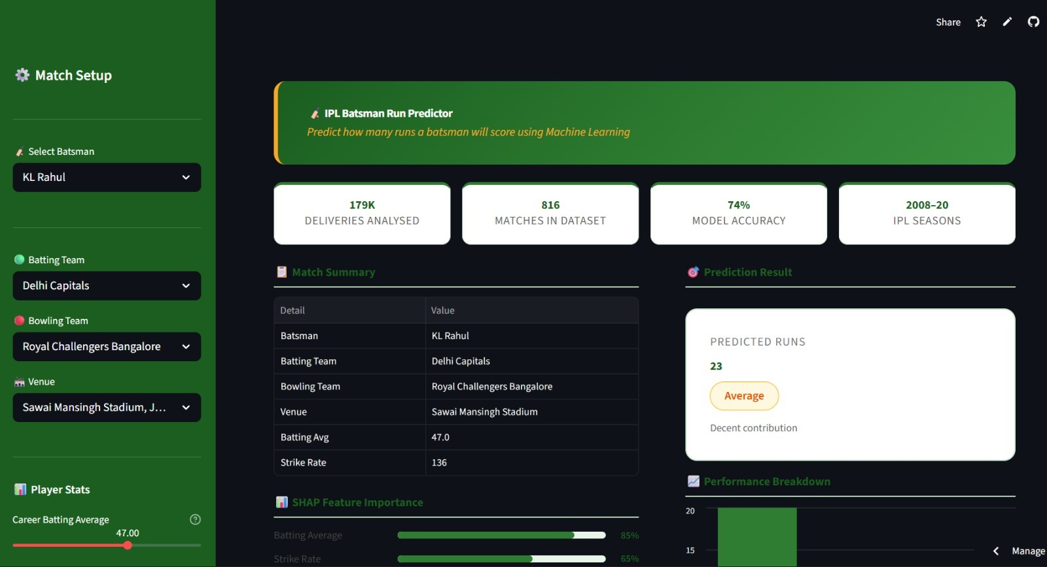
🚀 Deployment
Live App Screenshot
Platform Details
Platform:
Streamlit Cloud
Language:
Python
Models:
Linear Regression
Input:
Batsman, venue, teams
Output:
Predicted runs
Status:
Live ✓
ipl-predictive-analytics.streamlit.app

Slide 9
Conclusion & Future Work
Future Work
✅ Successfully predicted IPL batsman runs using 3 ML models
→ Add deep learning models
✅ Multiple Linear Regression achieved best accuracy of 74%
→ Include live IPL data
✅ SHAP revealed batting average as the key prediction driver
→ Bowler vs batsman analysis
✅ App deployed live on Streamlit Community Cloud
→ Team win prediction
Adithyan Biju • Fidal Govind • Archana T

